Slide 1


DATA
SCIENCE
6th DEC 2024
PREDICTING CUSTOMER BUYING BEHAVIOUR

Slide 2
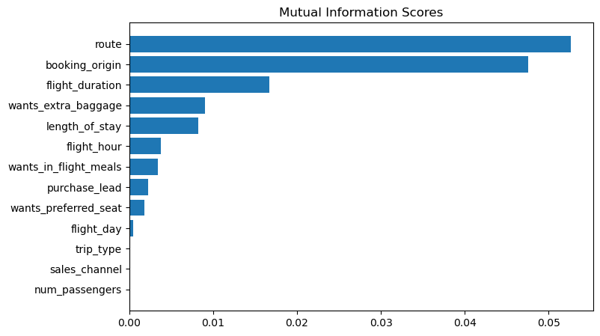
P R E D I C T I V E M O D E L T O U N D E R S T A N D F A C T O R S
T H A T I N F L U E N C E B U Y I N G B E H A V I O U R
We have trained the data set with the Random Forest Classifier and obtained Results:
ACCURACY : 85.37
AUC SCORE:0.568
route
booking _origin
flight_duration
wants_extra _baggage
length_of_stay
Are the top 5 features which influence
the customer buying behaviour

